Slide 2
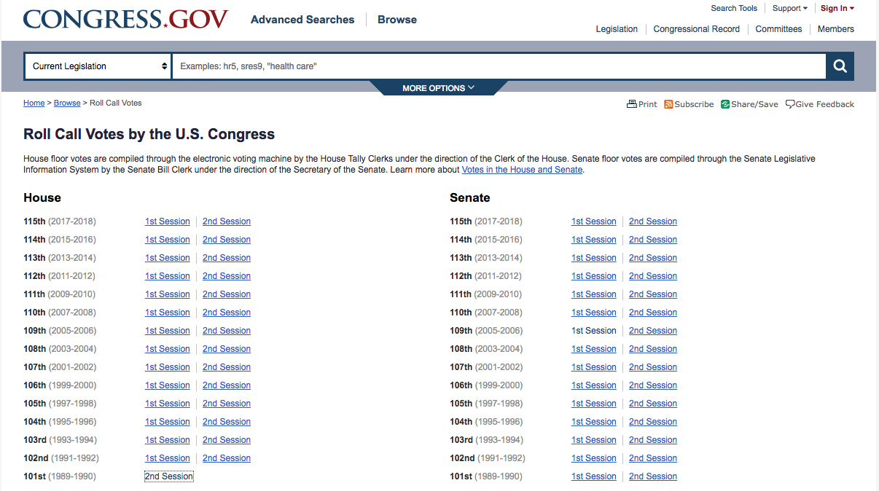
Data Collection
Roll Call Votes are listed by chamber, year, and session.

Slide 3
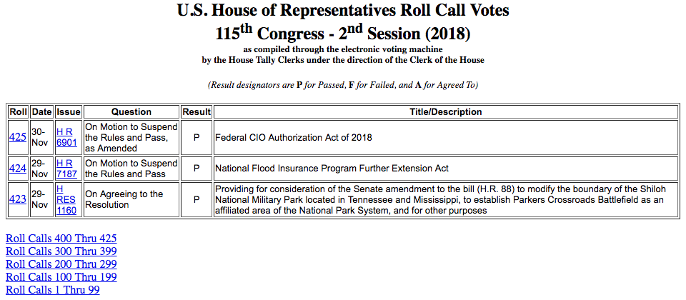
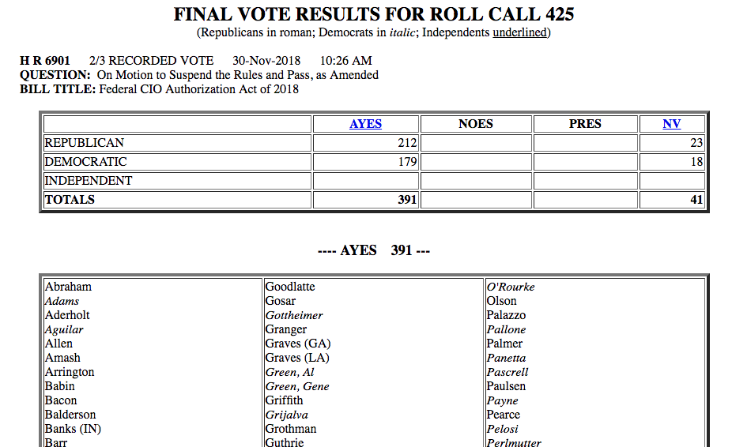
Data Collection
Roll Call Vote summaries are listed in tabular form.
This data was scraped, stored, and formatted.
Roll Call results are listed at the link provided at each Roll number.
This data was also scraped, stored, and formatted.

Slide 4
Data Collection
Roll Call Votes are listed by chamber, year, and session.

Slide 5
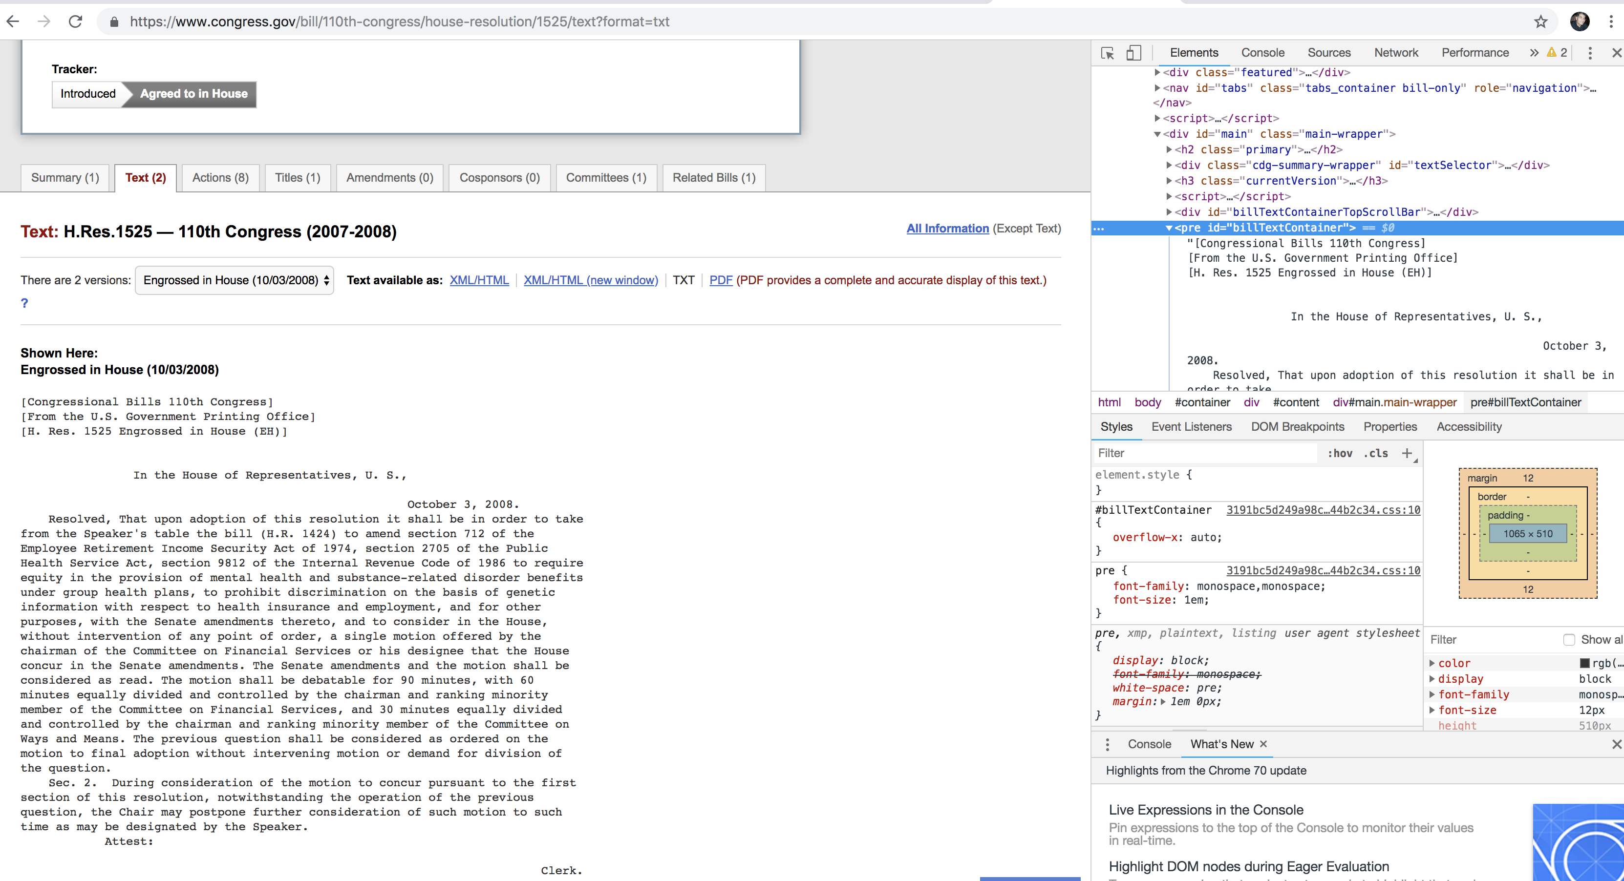
Data Collection
Used bill summary data to scrape the text of each bill. Wrote out to .jsonl file as it’s retrieved.

Slide 6
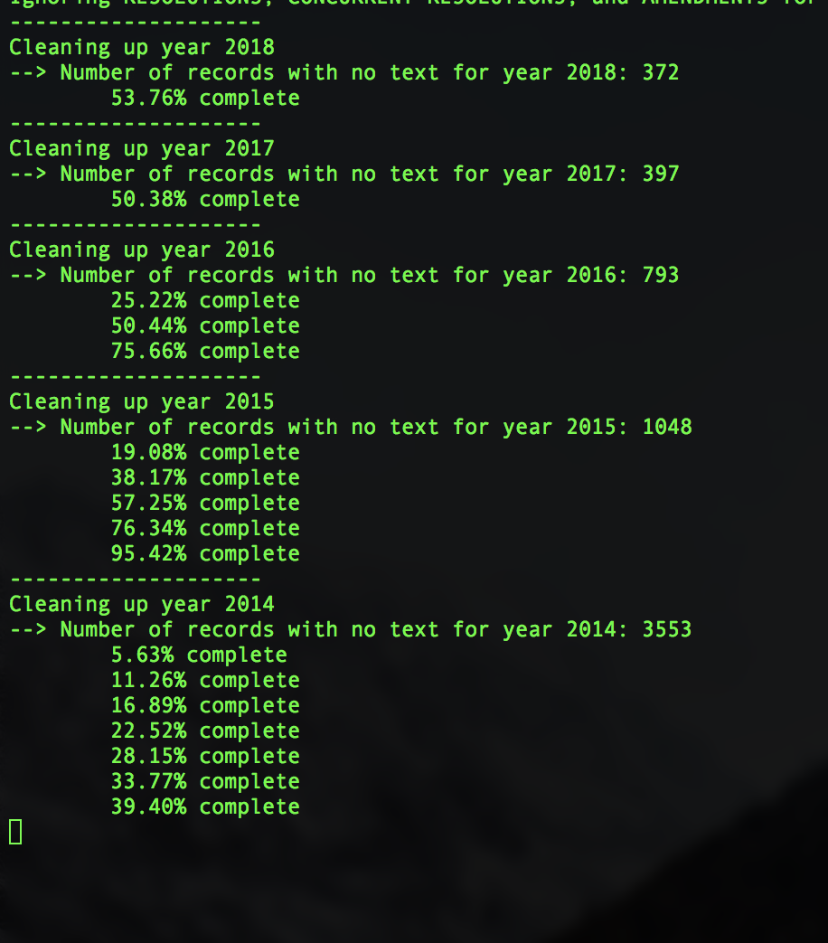
Output from mongo_cleanup.py

Slide 7
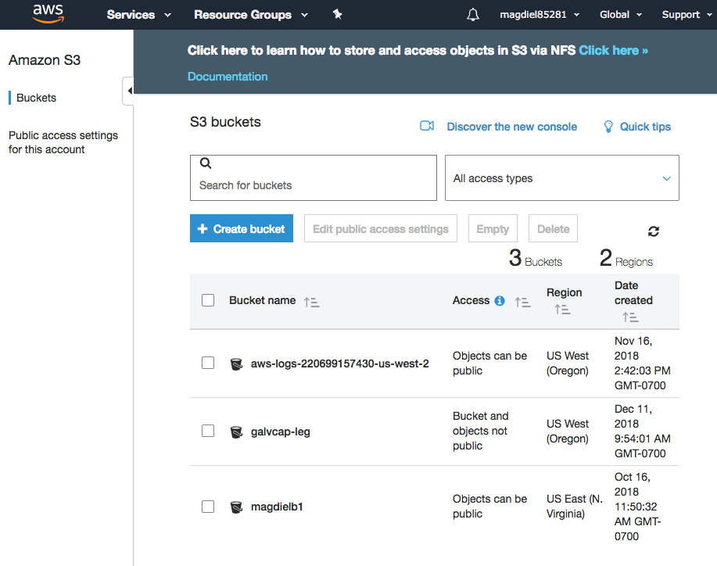
Amazon Web Services: Create an S3 bucket for our data.
Need to change access to write to the bucket galvcap-leg.

Slide 8
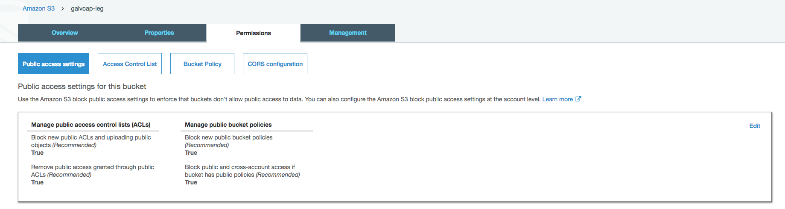
Amazon Web Services: Create an S3 bucket for our data.
Change all of the above values to False.

Slide 9
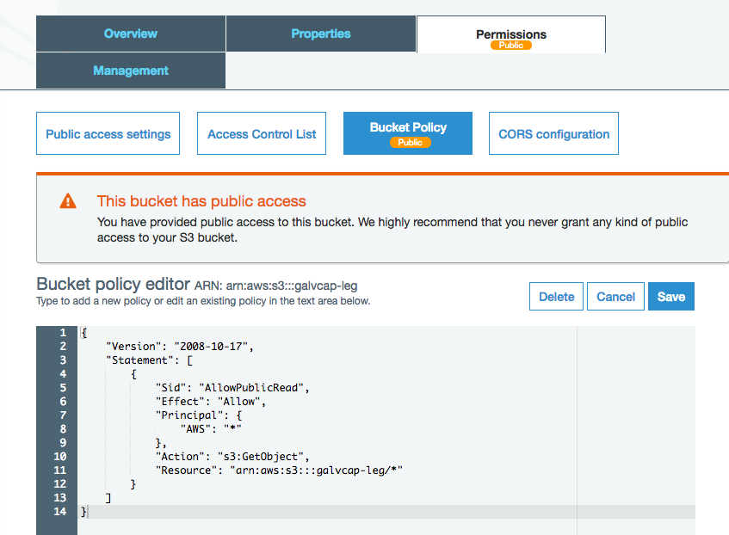
Amazon Web Services: Create an S3 bucket for our data.
Add the code below to change bucket policy.
Once the data is loaded, you may want to change access to the data so only the EC2 instance is able to retrieve what it needs.
{ "Version": "2008-10-17", "Statement": [ { "Sid": "AllowPublicRead", "Effect": "Allow", "Principal": { "AWS": "*" }, "Action": "s3:GetObject", "Resource": "arn:aws:s3:::<your bucket name>/*" } ] }

Slide 10
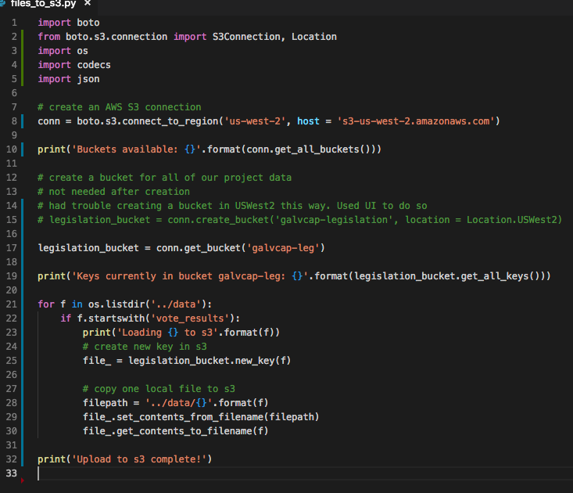
Code to upload to S3.
In order to avoid getting ERRNO 32 BROKEN PIPE, you need to specify host when initiating connection.

Slide 11
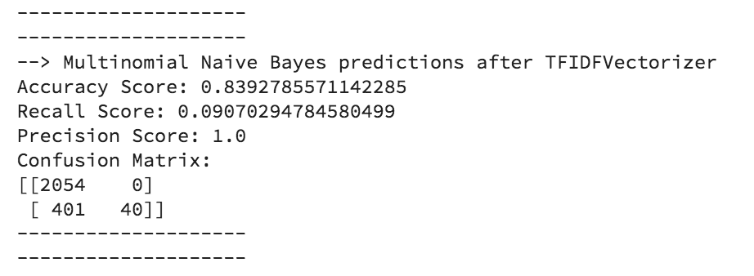
Natural Language Processing
TF-IDF: Term Frequency – Inverse Document Frequency
NLTK word_tokenize and stopwords
WordNetLemmatizer
Results of first iteration with subset of existing data as it’s still rolling in…

Slide 12
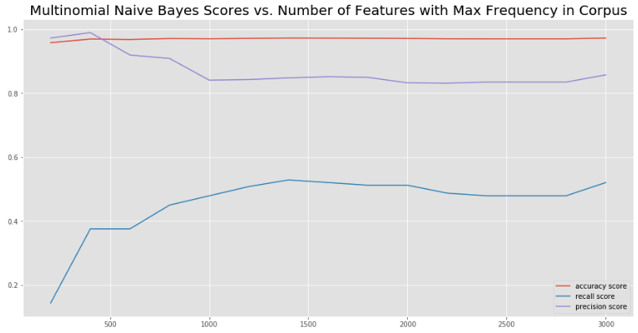
Examined how scores vary with the number of features with the highest frequency
Recall looks like it’s still going up…
Try a few more iterations

Slide 13
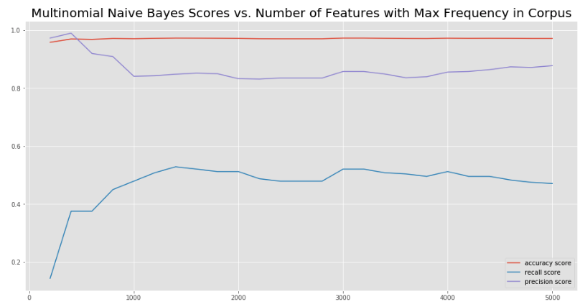
Doesn’t look like it’s improving much by increasing the number of features.
At this point, 3000 features seems to be the best without doing anything else to the model.

Slide 14
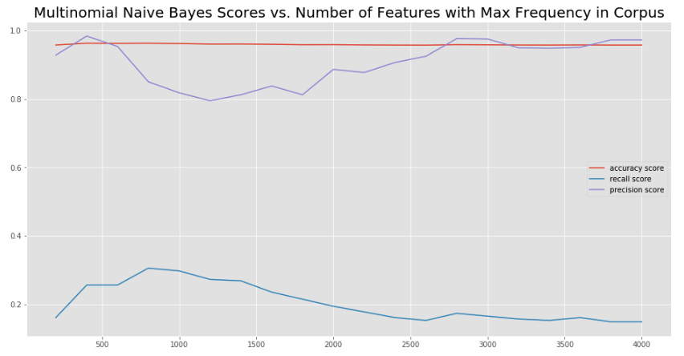
Alpha = 5
Recall maxes out at 800 features, but is only at around 3.5

Slide 15
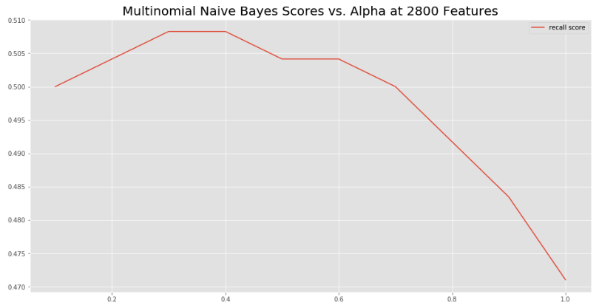
Our recall almost reaches .51 when alpha is between .3 and .4
Let’s up the features…

Slide 16
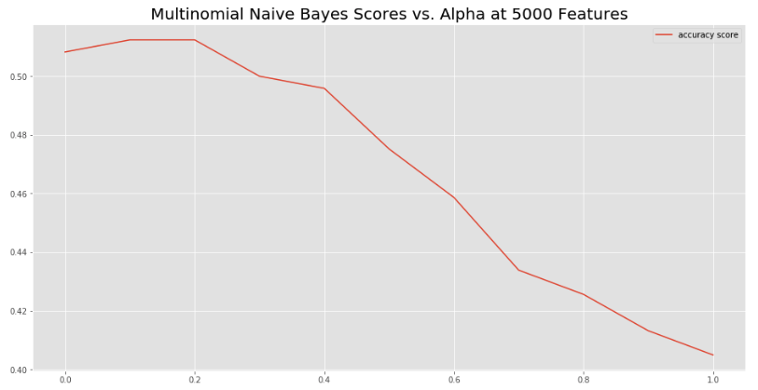
At 5000 features, alpha = 1.5 – 2 gives the best recall.
… splitting hairs at this point. Time to try some other approaches.

Slide 17
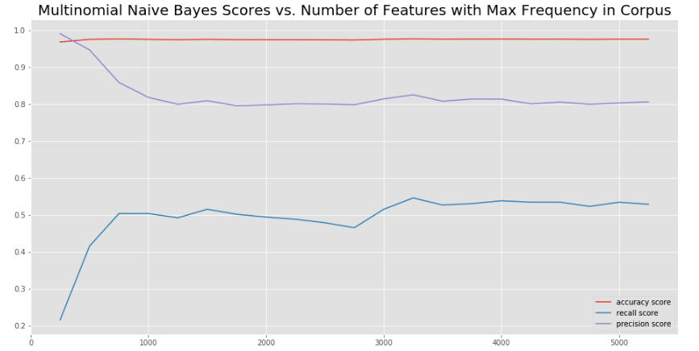
With a stratified train-test split the best recall score is specified below.

Slide 18
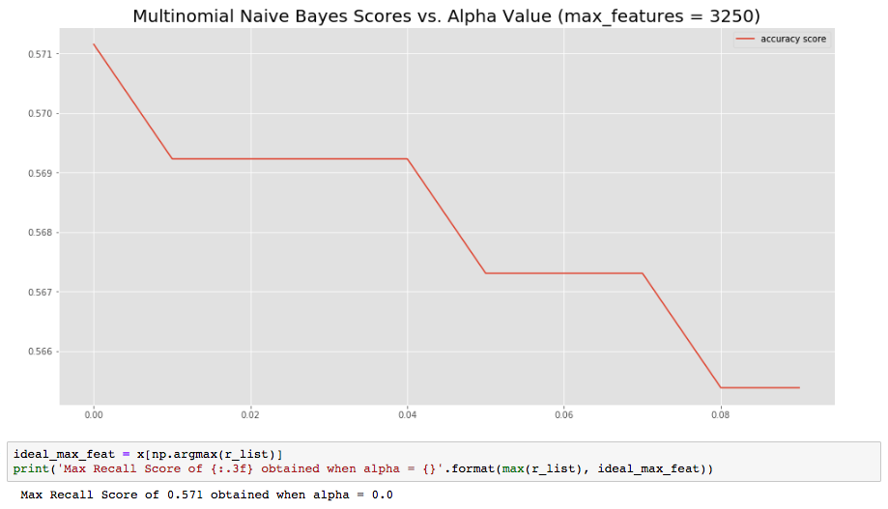
Keeping max_features at 3250, dial in the alpha in the Multinomial Naïve Bayes model

Slide 19
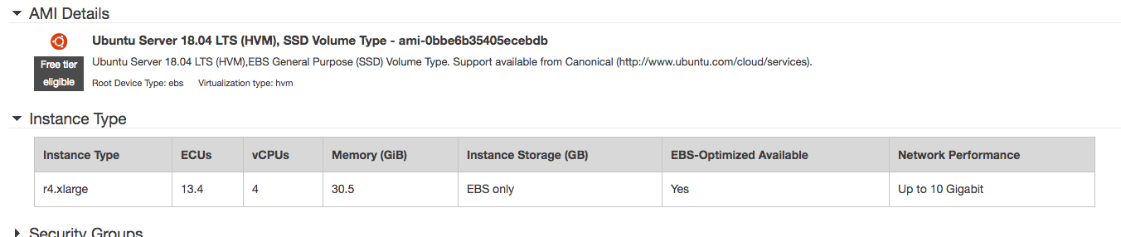
EC2 Instance

Slide 20
EC2 Instance
~/.ssh/config
Host galvanize_capstone
HostName ec2-34-221-255-8.us-west-2.compute.amazonaws.com
User ubuntu
IdentityFile ~/.ssh/galvanize_capstone.pem
Ssh galvanize_capstone
sudo apt update
sudo apt upgrade
wget -S -T 10 -t 5 https://repo.continuum.io/archive/Anaconda3-5.3.1-Linux-x86_64.sh -O $HOME/anaconda.sh
Source ~/.bashrc

Slide 21
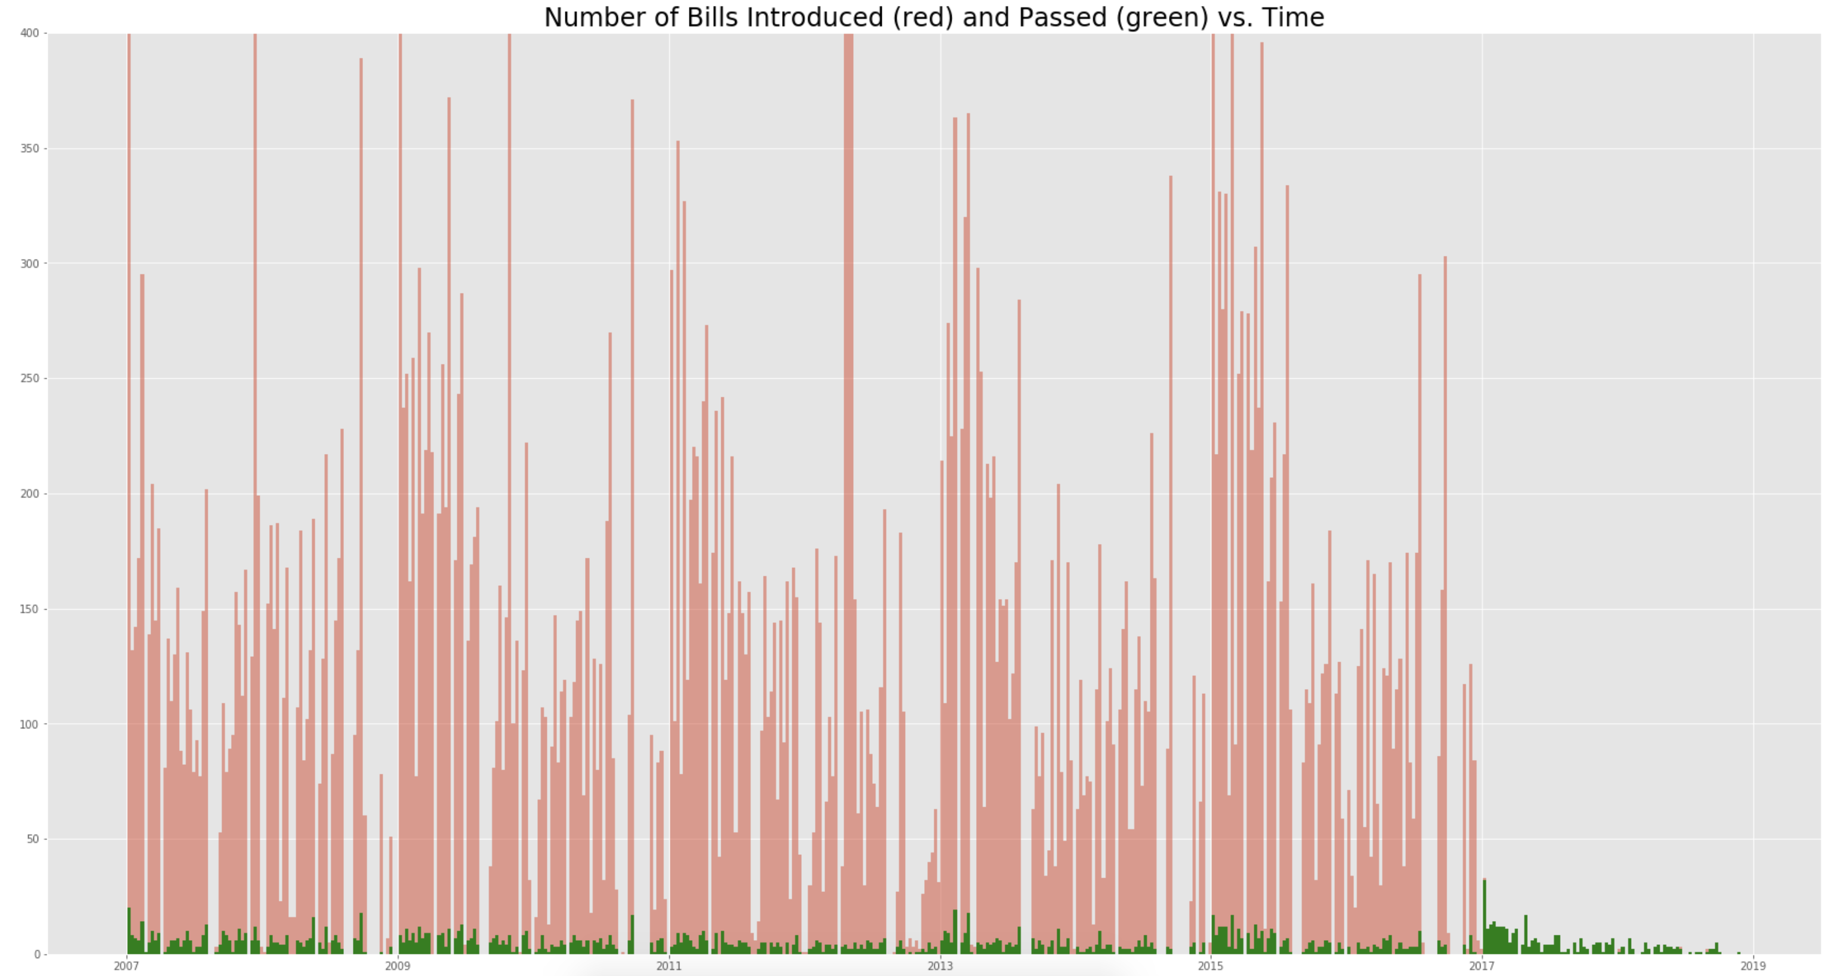
Trying to predict the bills that passed (in green)

Slide 22
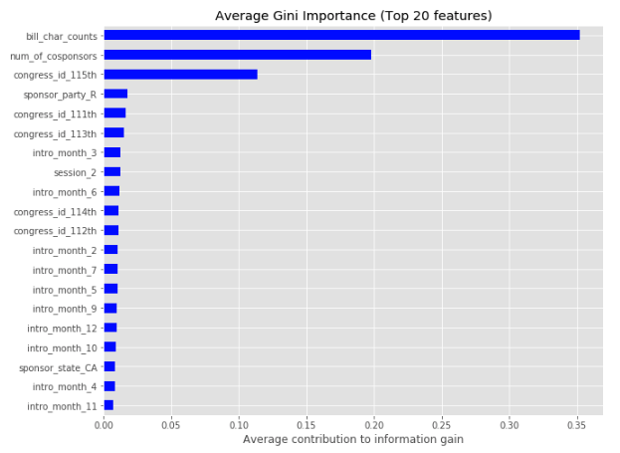
Random Forest Classification
Random Forest Classifier showing feature importance.
After looking at this, realized that the Congress ID will not be a part of the input data (every query will be from the most recent congress).
What happens if I take this out?

Slide 23
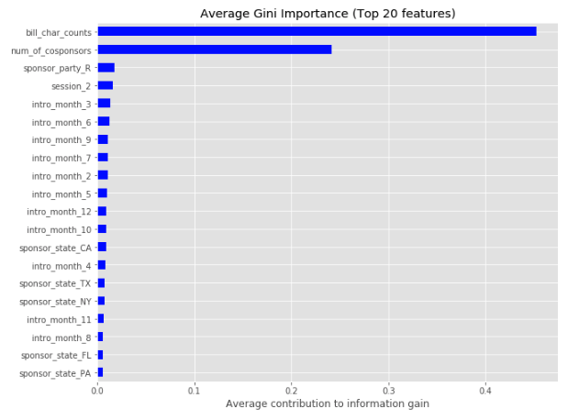
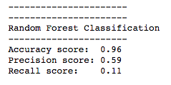
Random Forest Classification
Removing congress_id yields the following for feature importance…
Bill character counts and number of cosponsors are definitely important, but we get the following scores if we leave them in:
What happens if we remove them?

Slide 24
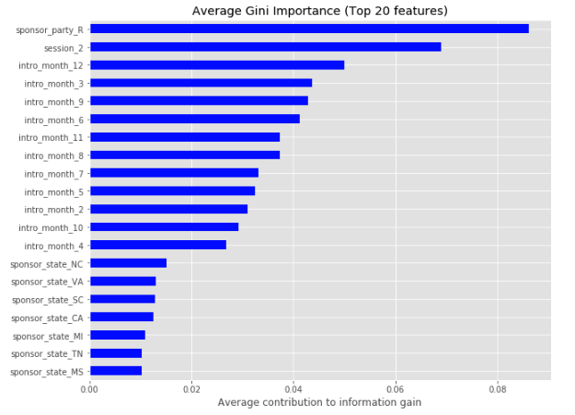
Random Forest Classification
With the dominating features removed, now we can see a little more detail on the importance of the other features.
In order to reduce the complexity of our model, we might be safe ignoring sponsor_state.
Our scores, though…

Slide 25
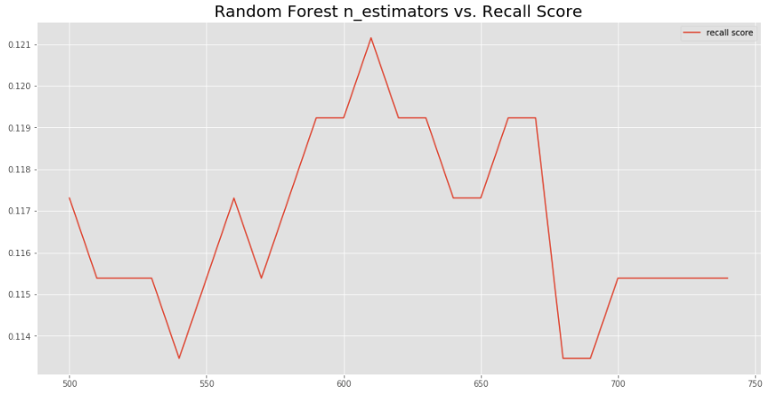
Random Forest Classification
Examination of how recall score varies with n_estimators.
Based on this, I set the n_estimators at 610

Slide 26
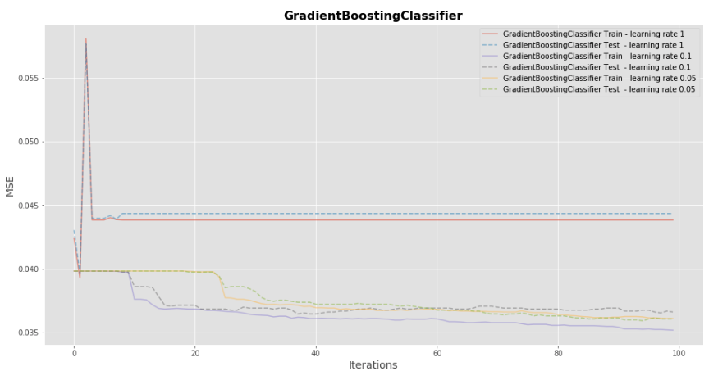
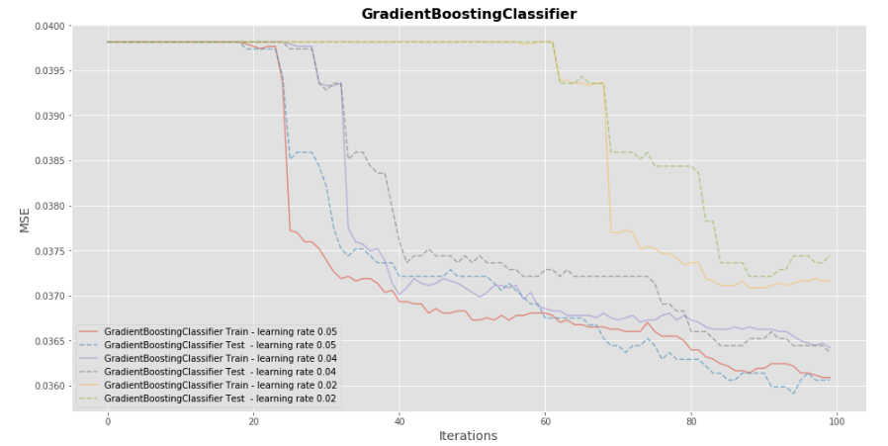
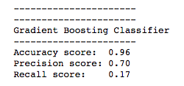
Gradient Boosting Classifier
With learning rate = .05, n_estimators = 100

Slide 27
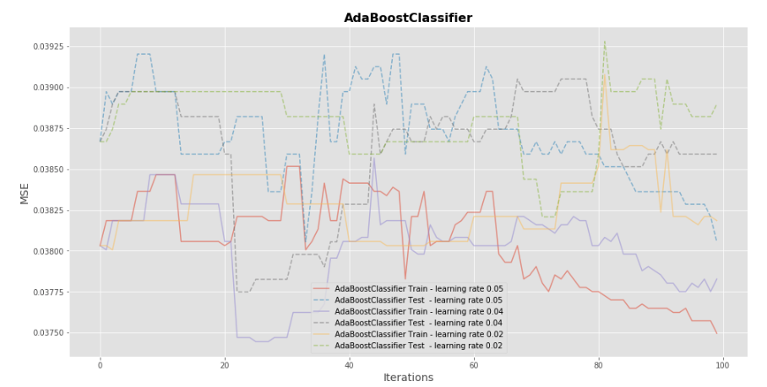
Max_depth = 3

Slide 28
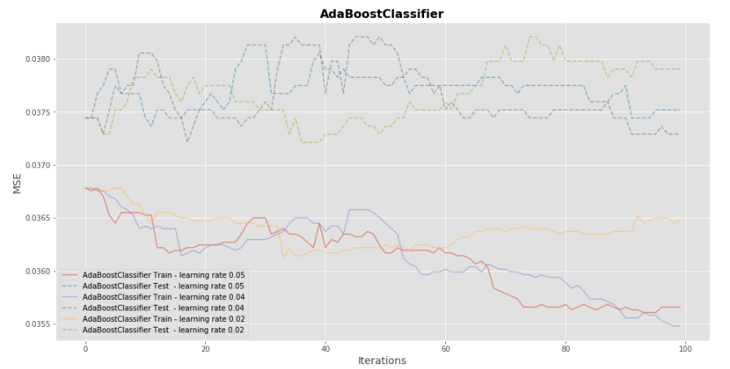
AdaBoost Classifier
Max_depth = 4

Slide 29
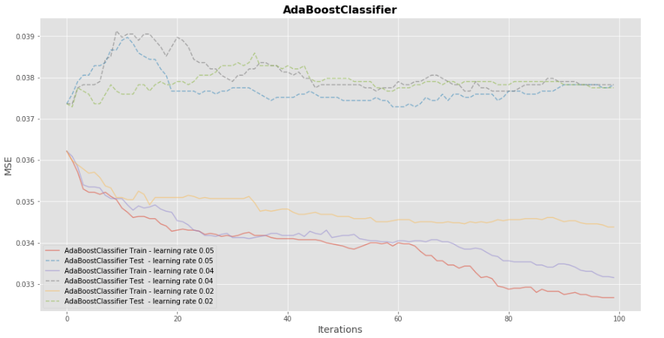
AdaBoost Classifier
Max_depth = 5

Slide 30
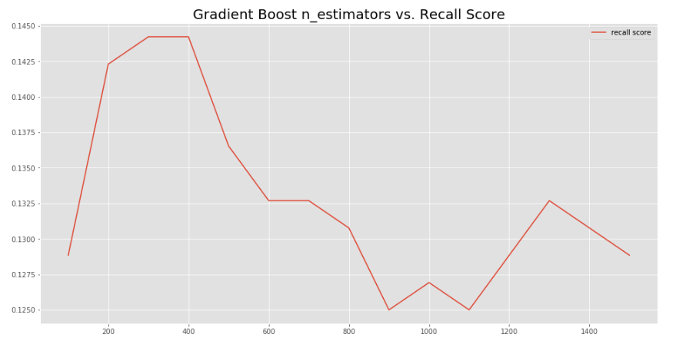
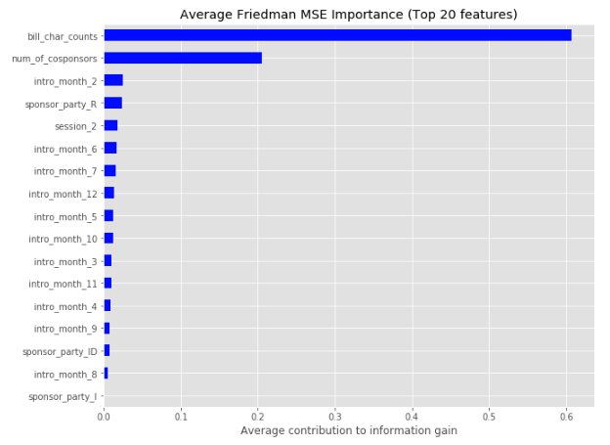
Trying the same by removing state
Learning_rate = .05

